Slide 1


Slide 2
HuggingFace Permissions in Google Colab

Slide 3
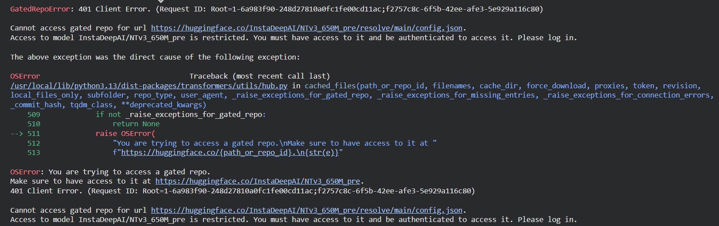
You may encounter a permissions error in Google Colab when trying to load a “gated access” model such as NTv3
More info: https://huggingface.co/docs/hub/en/models-gated

Slide 4
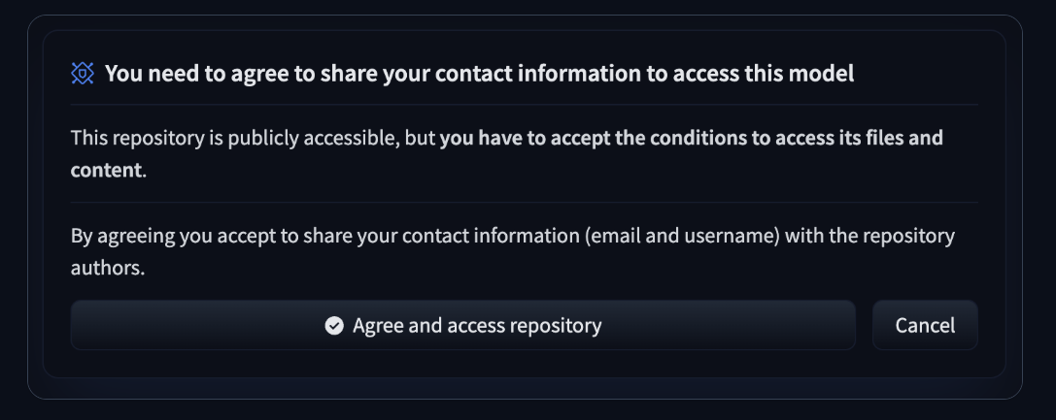
Step 1: Log in to your HuggingFace account and ensure you have access to the model
You should see something like the below on the model page.
More info: https://huggingface.co/docs/hub/main/en/models-gated#access-gated-models-as-a-user

Slide 5
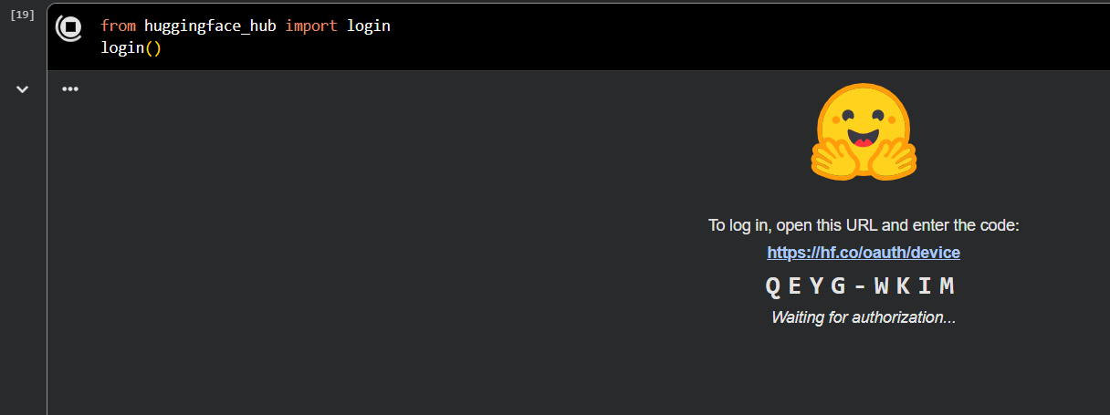
Step 2: Log in to HuggingFace in Google Colab
This can be done using the huggingface_hub package. Follow the URL, and input the code that appears in Google Colab.
Full instructions: https://huggingface.co/docs/huggingface_hub/en/quick-start

Slide 6
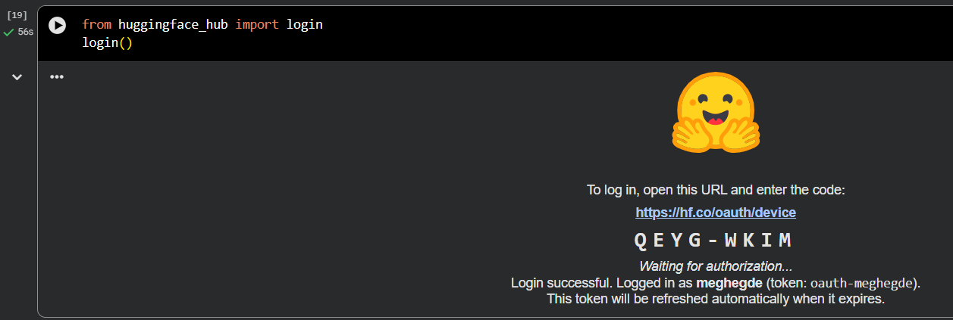
You should now be logged in and able to load the model

